Slide 1

Stock Market Analysis

Slide 2
Stock Market
TEAM MEMBERS: Group :- 2
Mr. Tushar Padavi
Mr. Suraj Tirgul
Mr. Dhiraj Hajare
Ms. Pooja Pawar
Mr. Saurabh Sigh
Mr. Alexander Kumarsamy
Ms. Nehal Mistry

Slide 3
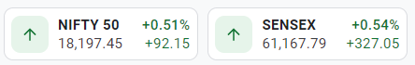
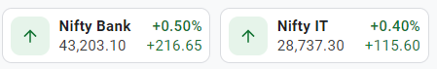
CONTENTS
01
Business Objective
05
Model Building
02
Data Collection
06
Deployment
03
Data Pre-Processing
04
Exploratory Data Analysis

Slide 4
Business Objective
01
Predict the Reliance Industries Stock Price for the next 30 days

Slide 5
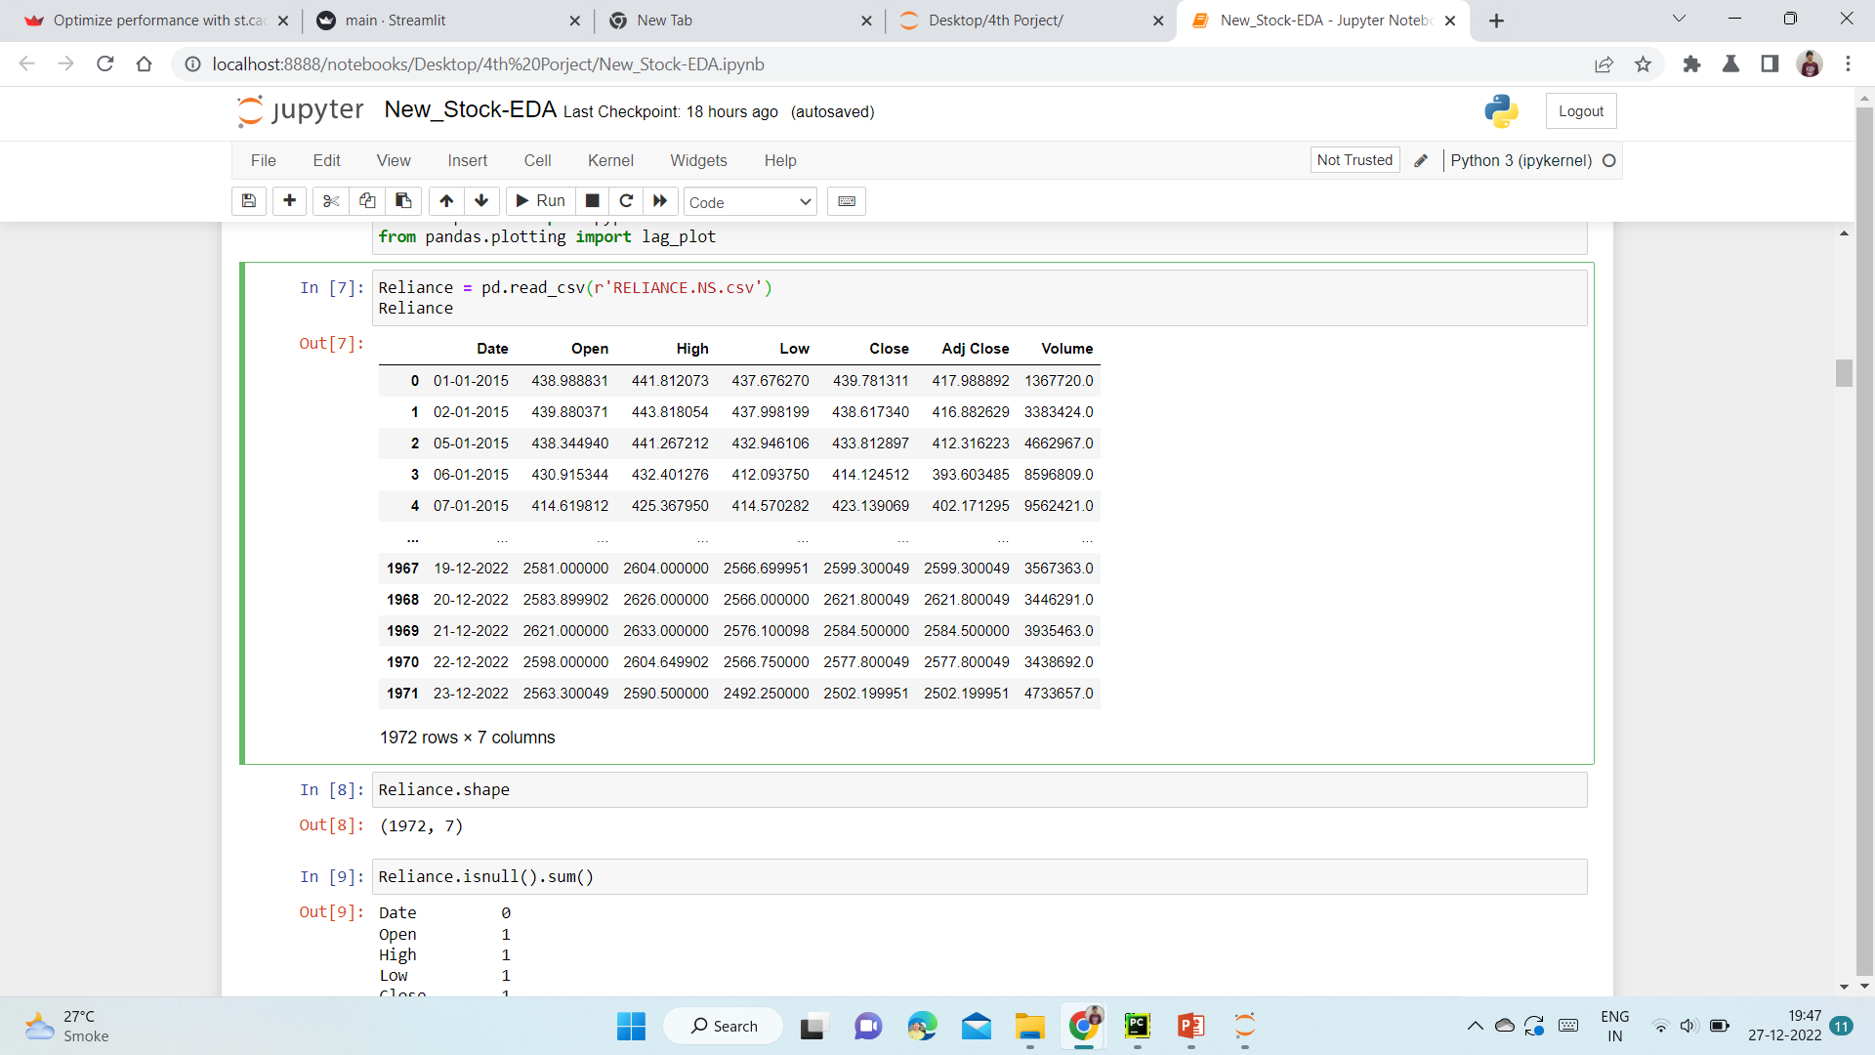
Data Pre-Processing
This is the data set of Reliance Stock
Range of the stock collected is 7 years (2015-2022)
basically this dataset contains 7 different features i.e. Date, Open, High, Low, Close, Adj Close, Volume
Date – This contains of the date of trade
Open – Open is the price when the
stock began
High – Maximum price at the given
time period
Low – Minimum price at the given time
period
Close – Price at which stock ended
Adj Close -Used to examine historical
returns
Volume –It is the total amount of
trading activity

Slide 6
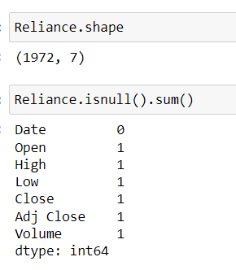
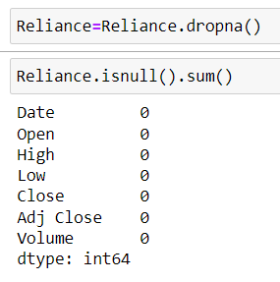
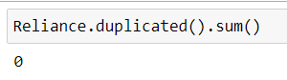
Exploratory Data Analysis
Data Set details:
Data of each company consists of 1972 entries & 7 columns
One Null Values
Drop Null Values .
No Duplicate Values.

Slide 7
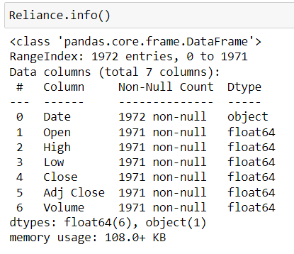
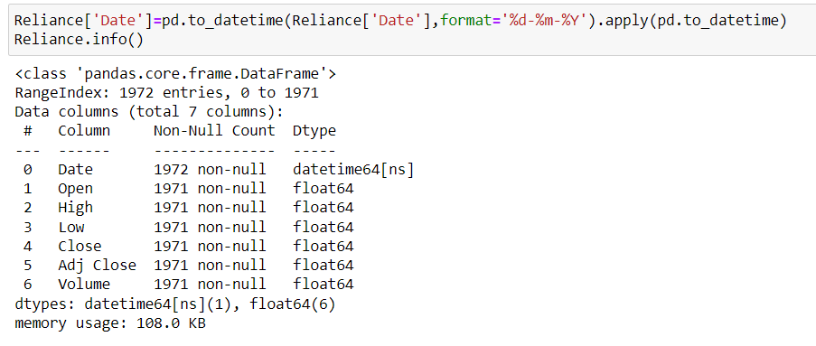
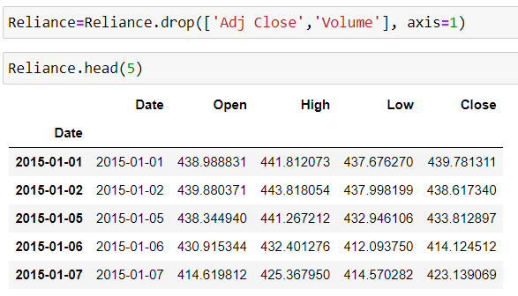
Datatype Changing
Datatype of consists one Object column and the rest four are numerical ( Float64 )columns.
Convert Datatype of Date column Object into Datetime64
Drop Adj Close and Volume Column

Slide 8
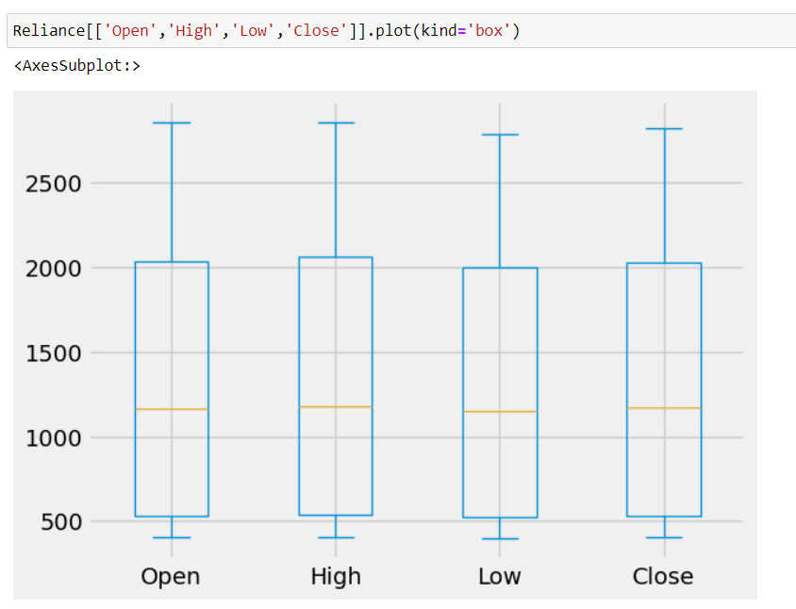
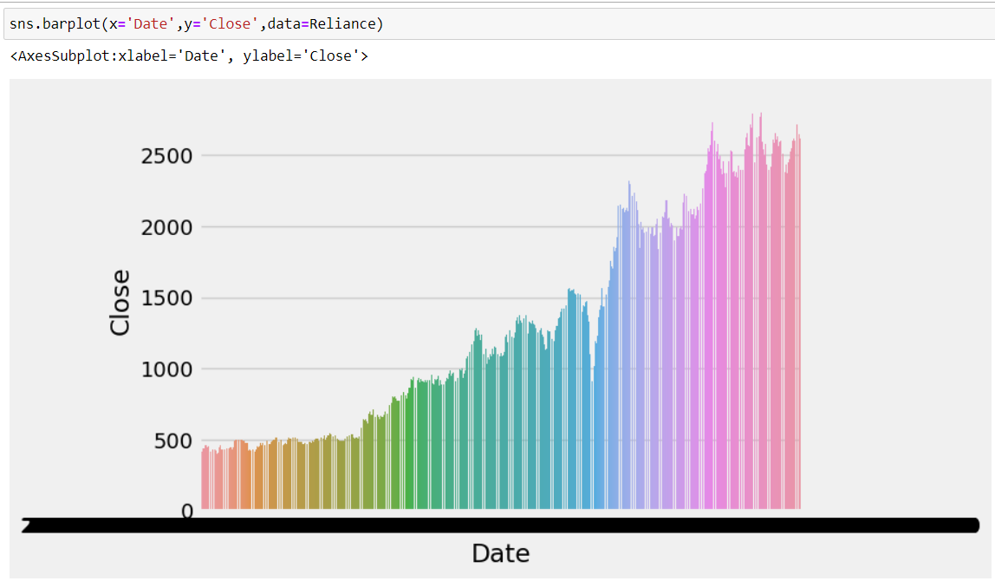
Plot and Boxplot
Boxplots –
columns are free from any outlier.
display the stock price at the close of the previous trading day.

Slide 9
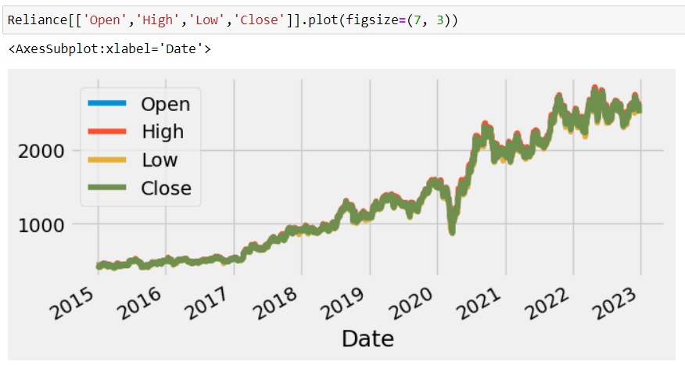
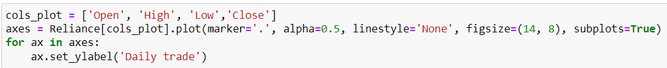
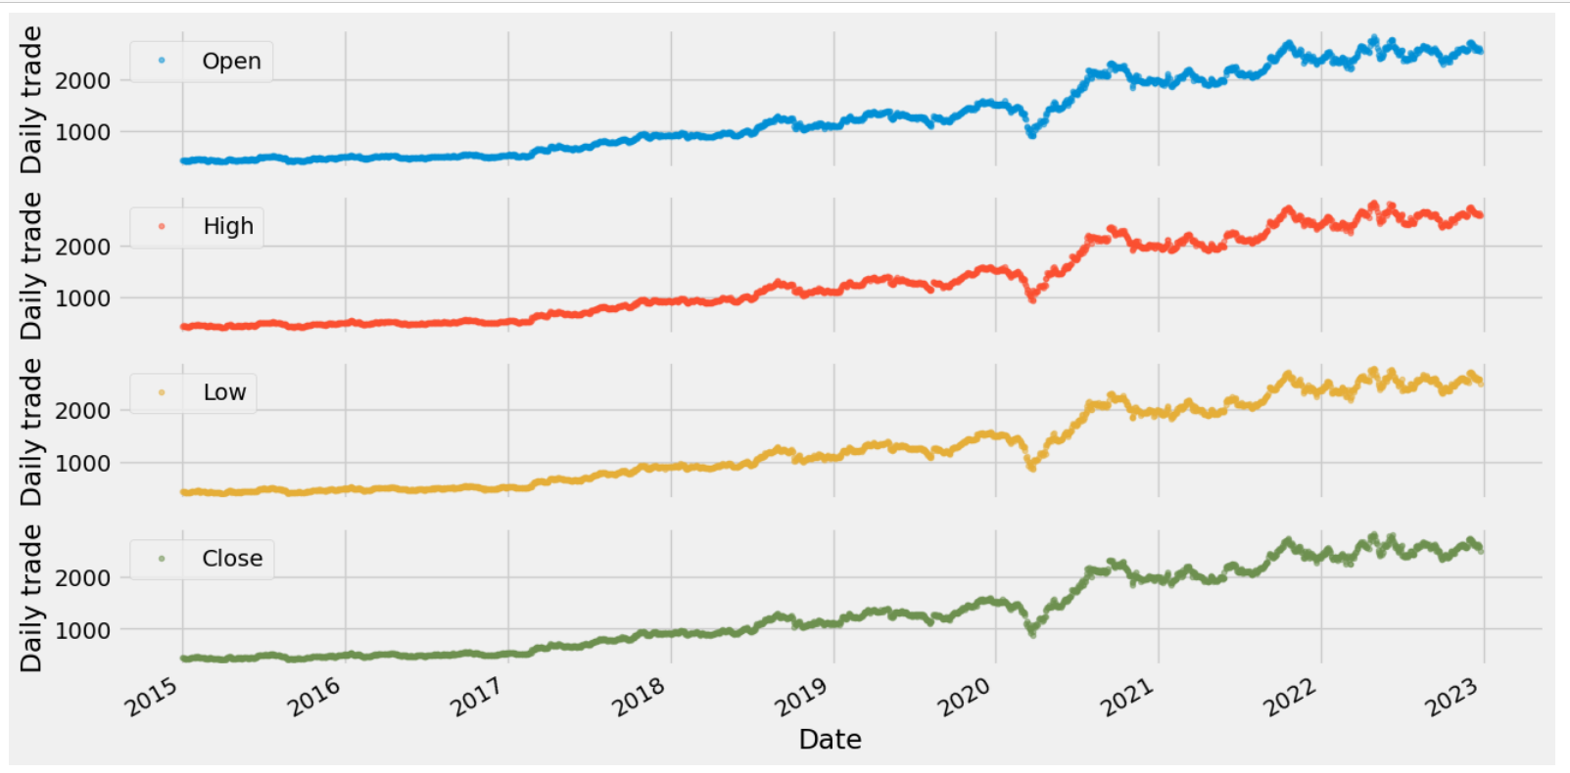
Daily Historical Trading Data
Historical Trading data for Open, High , Low and Close.

Slide 10
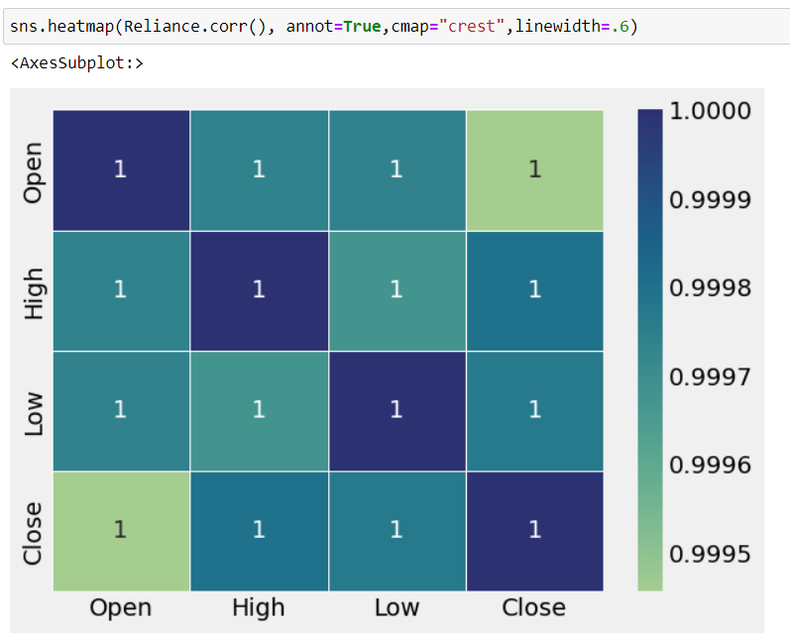
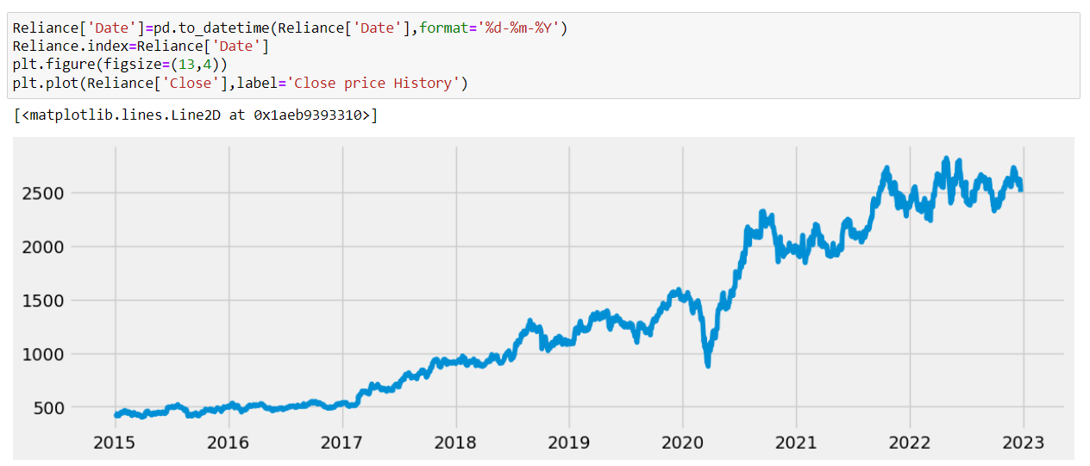
Heatmap and Line Plot
Heatmap –
we can say that there is a high correlation
between OHLC that is pretty obvious, and the added
features are not highly correlated with each other or
previously provided features which means that we are
good to go and build our model.
Line Plot –
A line chart is the
most basic type of stock
chart that tracks the
closing price of a stock
over time

Slide 11
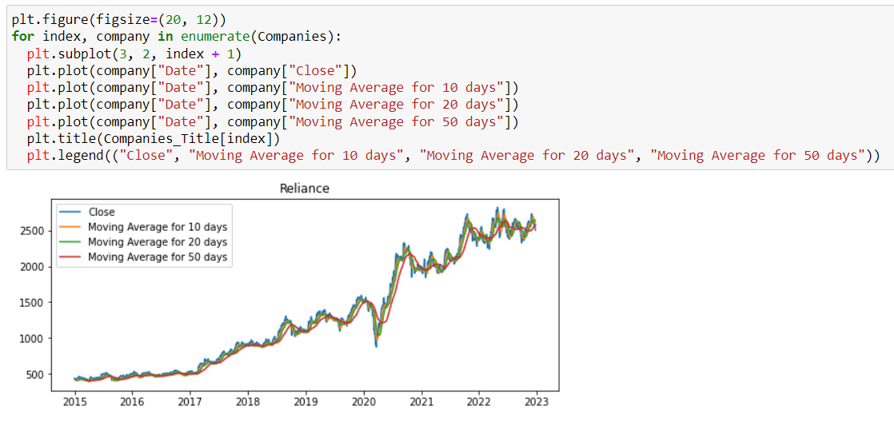
Calculated to Identify the Trend Direction of a Stock by using MA
A moving average (MA) is a stock indicator commonly used in technical analysis.
The moving average helps to level the price data over a specified period by creating a constantly updated average price.
A simple moving average (SMA) is a calculation that takes the arithmetic mean of a given set of prices over a specific number of days in the past.

Slide 12
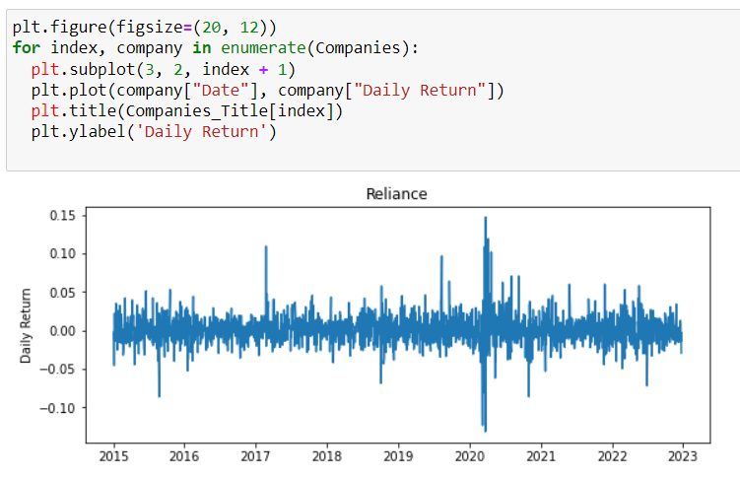
Daily Returns of the Stock
Now that we've done some baseline
analysis, let's go ahead and dive a
little deeper. We're now going to
analyze the risk of the stock. In order to do so we'll need to take a closer
look at the daily changes of the stock, and not just its absolute value

Slide 13
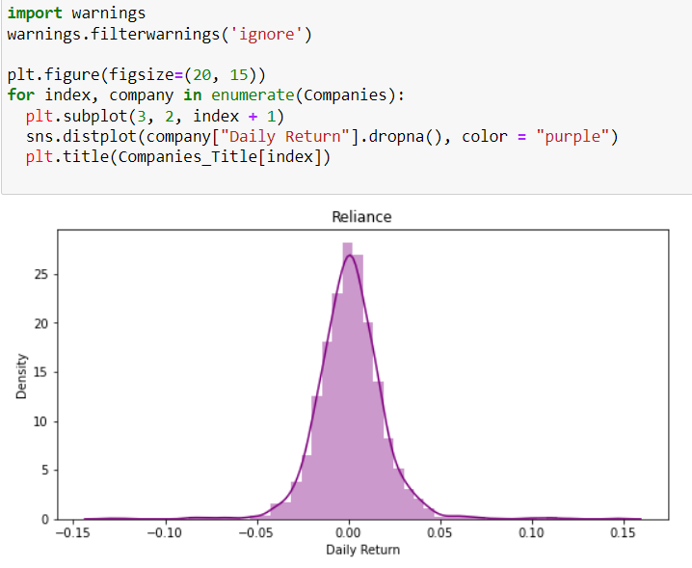
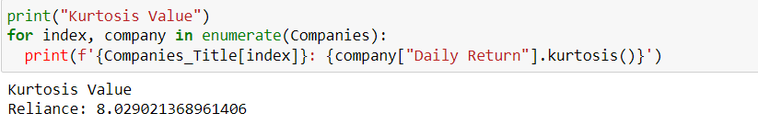
Kurtosis Value
Kurtosis is a statistical measure that defines how heavily the tails of a distribution differ from the tails of a normal distribution. In other words kurtosis identifies whether the tails of a given distribution contain extreme values
The above graph and the positive kurtosis value indicate that getting extreme daily return values is rare.

Slide 14
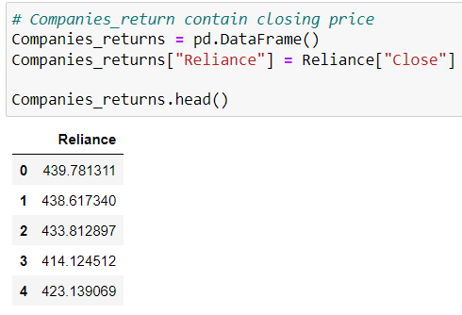
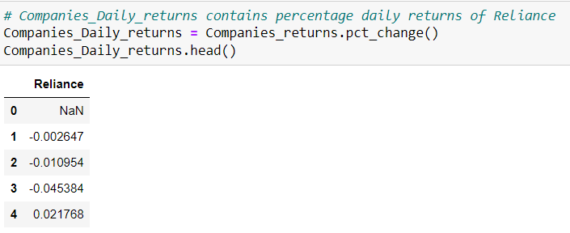
What was the correlation between different stocks closing price
Close and Daily Returns

Slide 15
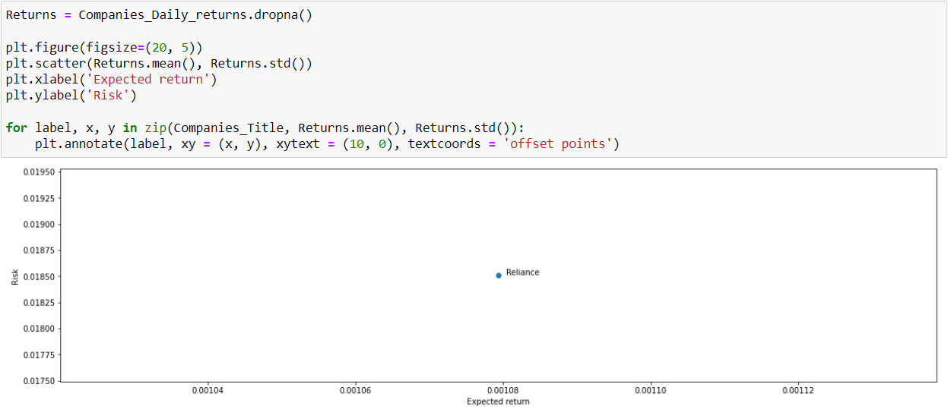
Risk by Investing in a Particular Stock
There are many ways we can quantify risk, one of the most basic ways using the information we've gathered on daily percentage returns is by comparing the expected return with the standard deviation of the daily returns.

Slide 16
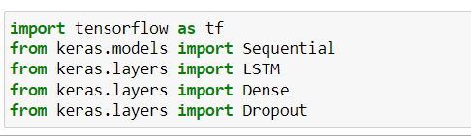
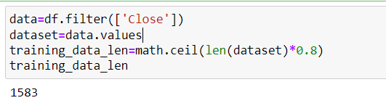
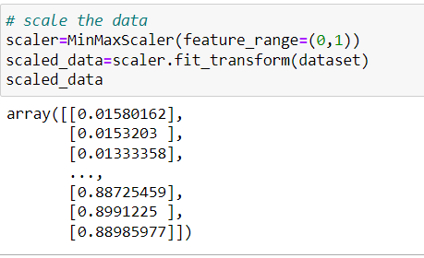
Model Building
create a data frame with only the close column
convert data frame to a NumPy array
80% of data given to train the model
Scale the data

Slide 17
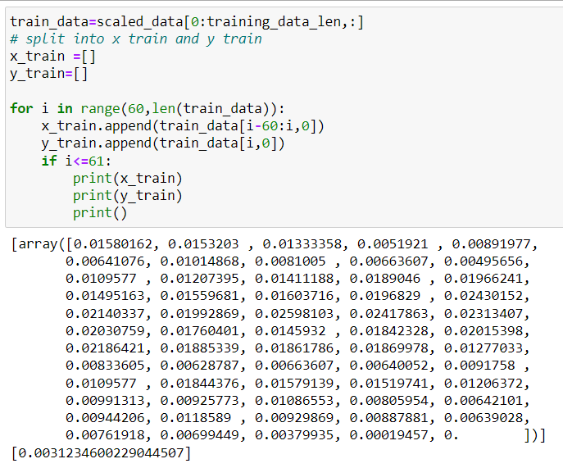
Train & Split Data
Create scaled training data set
Split data into x train and y train

Slide 18
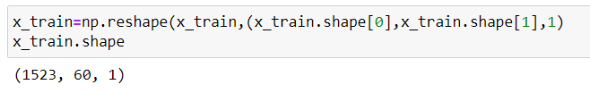
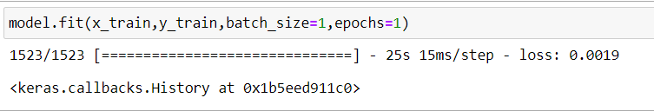
Train Model
convert x_train and y_train to NumPy arrays so that they can be used to train LSTM model
reshape the data cause currently our data is in 2d but LSTM requires 3d
batch size is total no.of training.
examples present in a batch
epoch is the number of iterations when a dataset is passed forward and backward in a neural network

Slide 19
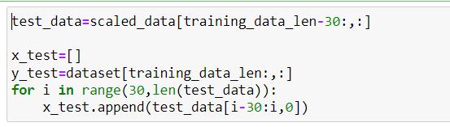
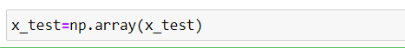
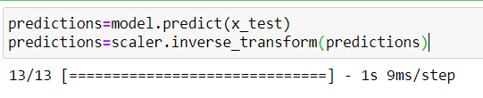
Testing Dataset
create testing dataset
create a new array containing scaled values
create datasets x_test and y_test values to be tested upon
convert data to NumPy array
Reshape data(2d to 3d)
Get Model’s Predicted Price Values
we want predictions to be same as y_test
and we are predicting on the basis of x_test

Slide 20
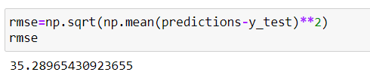
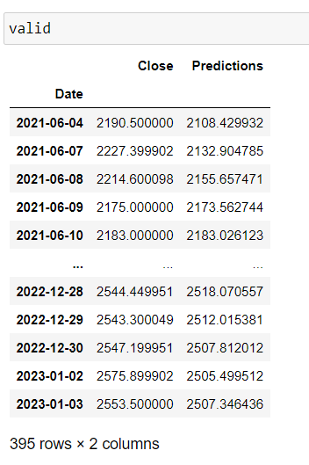
Model Prediction
evaluate model using root mean squared error[RMSE]
lower the RMSE better the fit
show the actual price and the predicted price

Slide 21
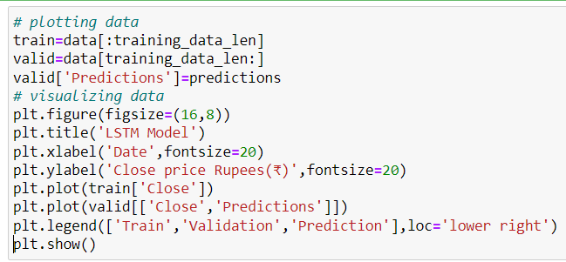
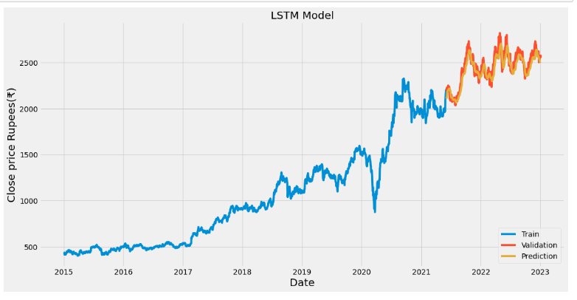
LSTM Prediction Model

Slide 22
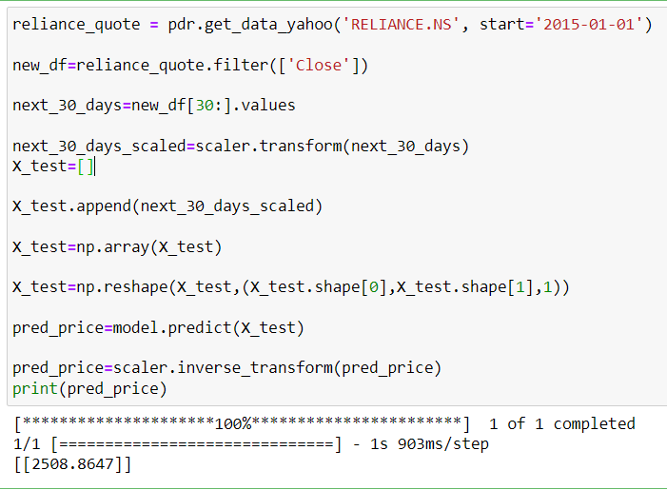
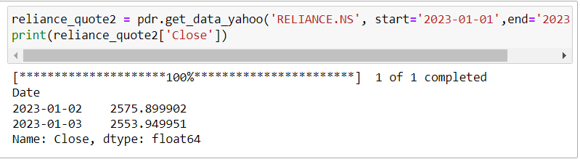
New Transform Data
Creating a new Data Frame
Getting next 30 days values and
converting to array
Scaling the value
Appending the last 30 days scaled value
converting to NumPy array
scaled predicted
unscaled predicted

Slide 23
THANK YOU

